Slide 1
Accessibility planning in America: Are we There yet?
David Proffitt¹, Keith Bartholomew¹, Reid Ewing¹, Harvey Miller²
¹University of Utah
²The Ohio State University

Slide 2
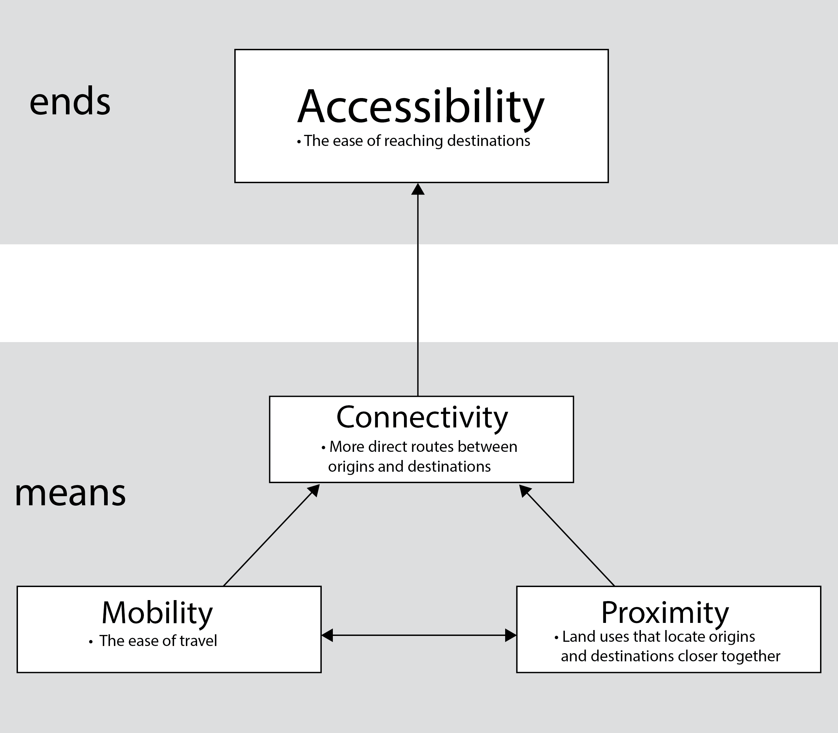
Gap between Research & practice
Terms often conflated in practice:
Mobility: individuals’ ability to travel farther and faster
Accessibility: individuals’ ability to reach places where they can meet daily needs
“[A]ccessibility in the U.S. is largely mobility dependent, and mobility in the U.S. is largely car-dependent” (Handy, 2005).
“[L]ittle integration between transport and land use planning is to be seen in practice” (Bertolini, Le Clerq & Straatmeier, 2008).
“Transportation planning is undergoing its own paradigm shift, and it is changing the way we define transportation problems and how we evaluate transportation system performance” (Litman, 2013).
Adapted from Levine, Grengs, Shen & Shen (2012)

Slide 3
Study goals
Do MPOs focus more on mobility than accessibility?
What are the characteristics of accessibility vs. mobility oriented regions?
What are the obstacles to a wider adoption of the accessibility paradigm?
Notes:
Do MPOs focus on more on mobility than accessibility?
What are the characteristics of mobility vs. accessibility focused regions?
What are the obstacles to a wider adoption of the accessibility paradigm?

Slide 4
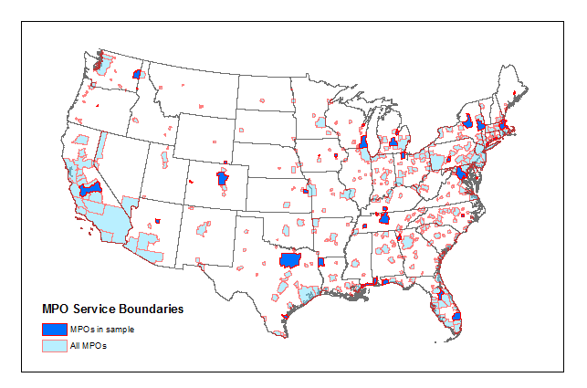
Snapshot of practice
Content analysis: Produce accessibility index to assess how accessibility is used in a sample of 42 RTPs.
14 yes/no questions
Focus on internal consistency of term definition, goals, project-evaluation criteria + performance measures
Regression tree: Accessibility index scores partitioned by
MPO population
MPO Population density
Income per capita
VMT per capita
Average fuel price (by metro)
Highway lane miles per capita
Transit route miles per capita
Transit revenue miles per capita
42 RTPs analyzed for a nationally representative sample
Notes:
There are currently 409 MPOs in the U.S.

Slide 5
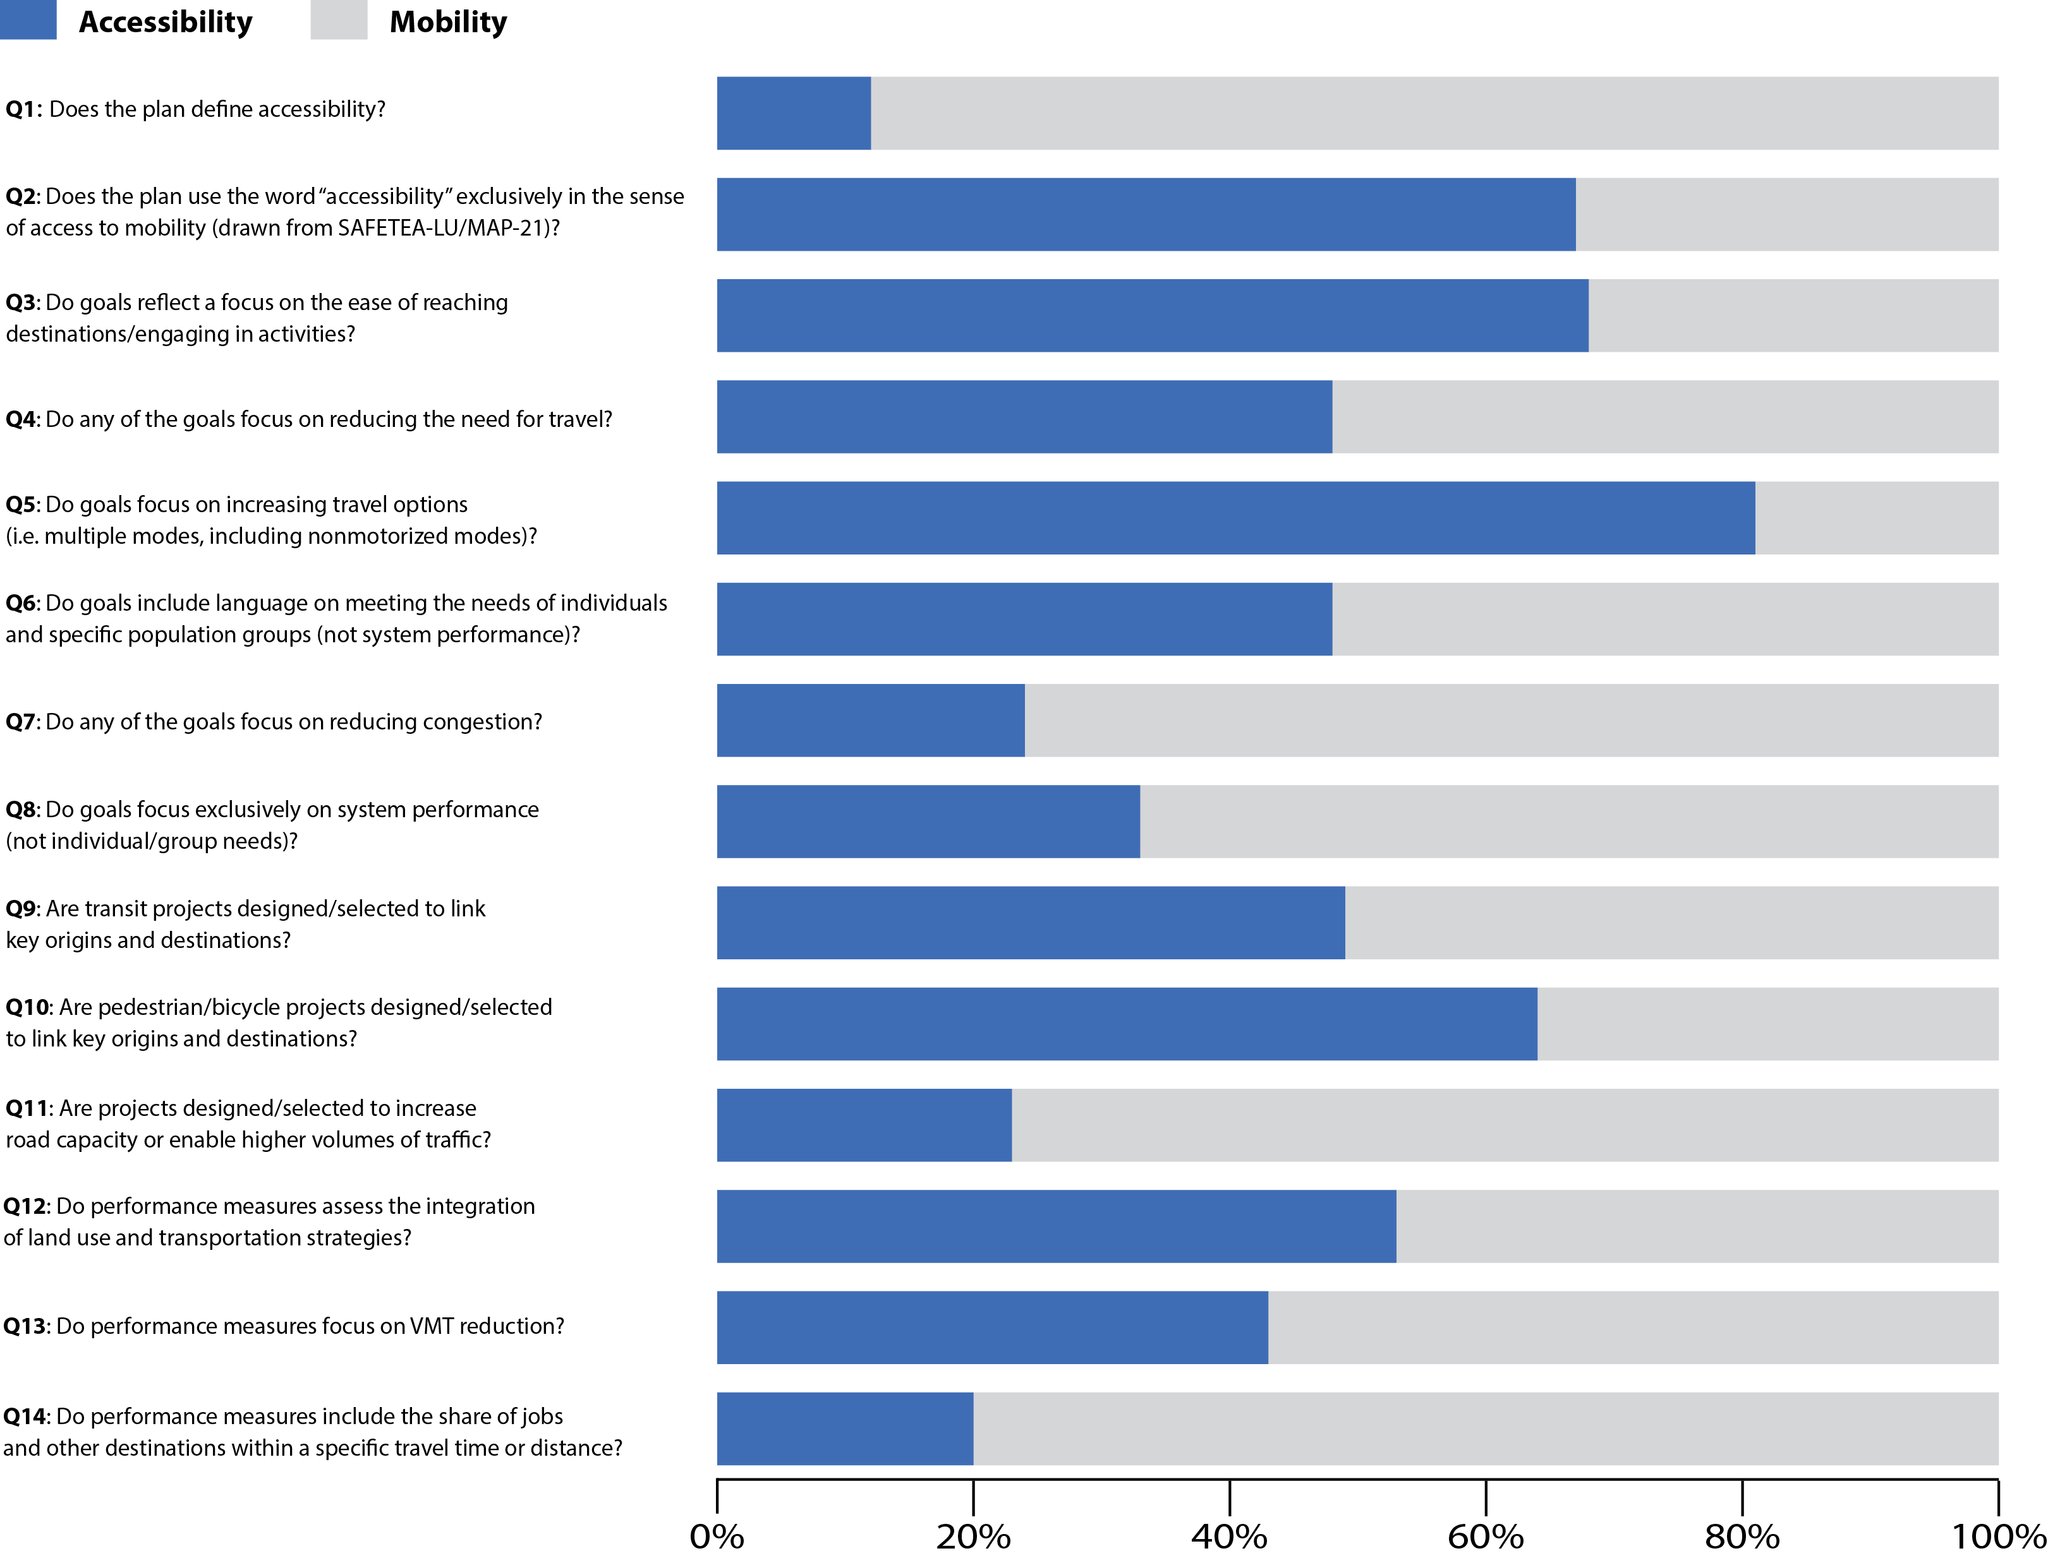
Results: Accessibility Index
Notes:
Almost none of the MPOs in our sample define accessibility. Just about 15% have an explicit definition.
Federal planning guidelines discourage the adoption of an accessibility orientation in RTPs.
“Accessibility and mobility” formulation in MAP-21/SAFETEA-LU conflates terms; neither term is explicitly defined in guidelines.
Fully 1/3 of all plans analyzed use the phrase “accessibility & mobility” exclusively.
Very few plans use accessibility-related performance measures.
Congestion reduction is still the main goal and project selection crieterium used.
Financial incentives for highway projects encourage mobility orientation in RTPs. Aligning funding with accessibility goals and metrics would allow MPOs to shift focus beyond roadway expansion.

Slide 6
Policy Barriers
Federal planning guidelines discourage the adoption of an accessibility orientation in RTPs. “Accessibility and mobility” formulation in MAP-21/SAFETEA-LU conflates terms; neither term is explicitly defined in guidelines.
Fully 1/3 of all plans analyzed use the phrase “accessibility & mobility” exclusively.
Financial incentives for highway projects encourage mobility orientation in RTPs. Aligning funding with accessibility goals and metrics would allow MPOs to shift focus beyond roadway expansion.

Slide 7
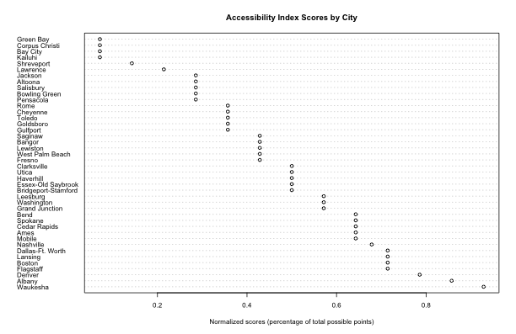
Accessibility Index Scores by Region

Slide 8
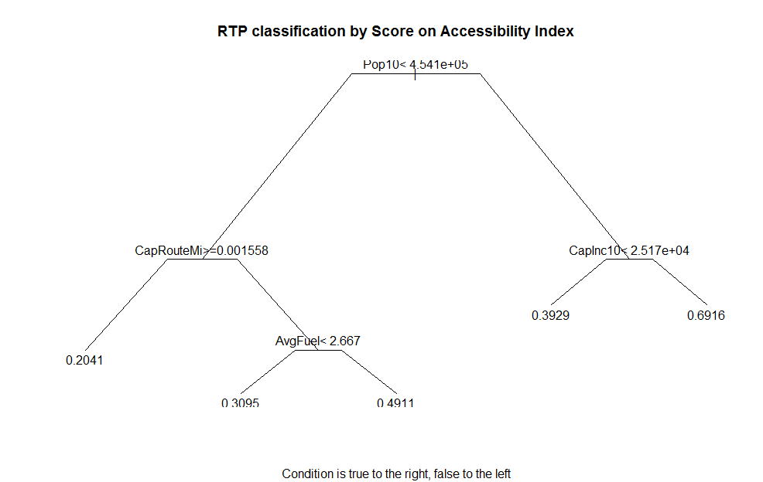
Results: accessibility focused MPOs
Notes:
MPO planning capacity matters: Bigger MPOs with higher-income populations have the highest accessibility index scores.
Cost of driving matters: Regions where fuel is expensive have higher accessibility index scores.
Local support matters: Smaller regions with relatively more transit and cheaper gas have lower accessibility index scores.

Slide 9
Policy barriers
MPO planning capacity matters: Bigger MPOs with higher-income populations have the highest accessibility index scores.
Cost of driving matters: Regions where fuel is expensive have higher accessibility index scores.
Local support matters: Smaller regions with relatively more transit and cheaper gas have lower accessibility index scores.

Slide 10
Recommendations for policy
Define accessibility in federal planning guidelines: Successor to MAP-21 should present accessibility as a higher-order concept comprised of mobility and proximity.
Improve MPO planning capacity: Smaller MPOs in particular need assistance compiling data and calculating accessibility metrics.
Mandate accessibility metrics:
Could give MPOs more influence over local land-use decisions even without additional legal authority.
Increases transparency of motivations for local land-use decisions.

Slide 11

Thank you!
DAVID PROFFITT
Department of City + Metropolitan Planning, University of Utah
david.proffitt @utah.edu
Acknowledgements:
The material in this paper is based on research supported by National Science Foundation under grant no. BCS-1224102.

Slide 12
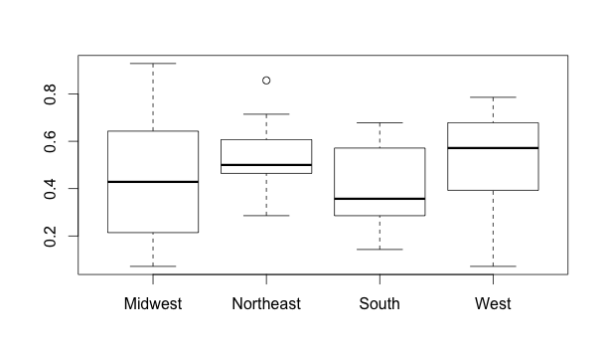
Accessibility Index Scores
Notes:
Higher scores in West attributed to generally more attention to transit. Generally more often listed as a goal to provide more modes and more likely to connect key origins and destinations.

Slide 13
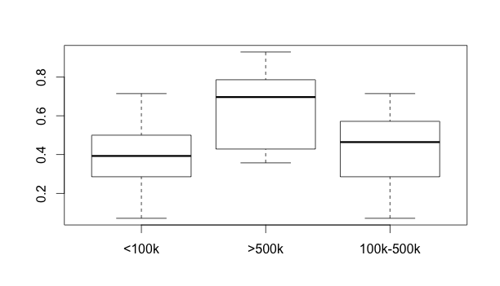
Accessibility Index Scores
Notes:
Most of the difference in scores attributed to higher propensity for bigger MPOs in sample to use wider variety of performance measures, often more accessibility oriented.

Slide 14
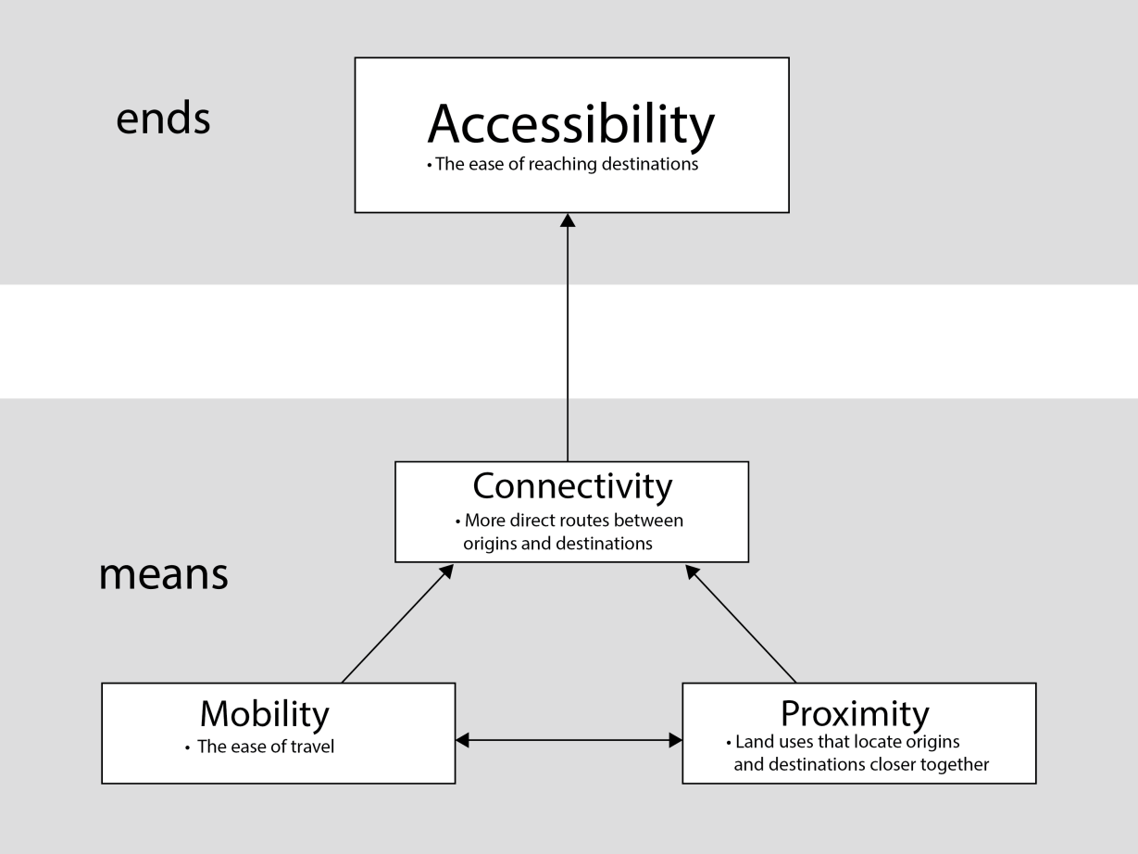
Accessibility vs. mobility
Travel is a “derived demand”
Accessibility is the end goal of the transportation system – mobility only one means to this end
Delinking transportation planning from planning for vehicles:
Environmental advantages
Health advantages
Financial advantages (at least savings on urban highways)
Adapted from Levine, Grengs, Shen & Shen (2012)

